Slide 1

Python Fundamentals
Lab 2

Slide 2
Learning outcomes:
At the end of this Lab 2, you should be able to:
understand Python basics
why Python
features
use editors
complete examples

Slide 3
Python features:
Python is a general purpose interpreted high-level programming
language.
Current version is 3.4.3 available for UNIX, Mac and Windows
It is case sensitive (print and Print are different)
Python is Interpreted: Processed at runtime by the interpreter (similar
to PERL and PHP).
Python is Interactive: You can write your programs at command prompt.
Easy to learn: It has relatively few keywords, simple structure, and a
clearly defined syntax.
Interpreter & IDE are free.

Slide 4
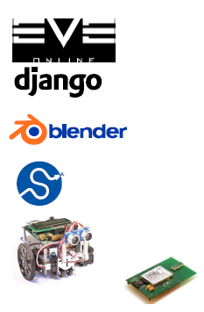
Who uses Python?
On-line games
Web services
Applications
Science
Instrument control
Embedded systems
Google extensively uses Python

Slide 5
Running Python
There are three different ways to start Python:
Interactive Interpreter: You can enter python and start coding right away in the interactive interpreter by starting it from the command line. Command-line interpreter or shell window. Launch LX terminal then launch a shell, type
pi@raspberry ~ $ python
>>> print (“Hello, world!”)
Hello, world!
>>>
Save your Python program as a text files, e.g. using a text editor like Leafpad.
Integrated Development Environment (IDLE) - IDLE: You can run Python code from a graphical user interface (GUI) environment, using a
GUI based IDE on your system to program in Python.

Slide 6
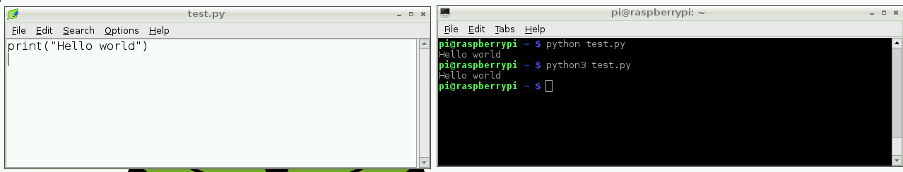
2. Executing Python script using a
command line
You can write a Python file in a standard editor like Vim, Nano or LeafPad, and run it
as a Python script from the command line.
Just navigate to the directory the file is saved (use cd and ls commands) and run with
python, e.g. python hello.py

Slide 7

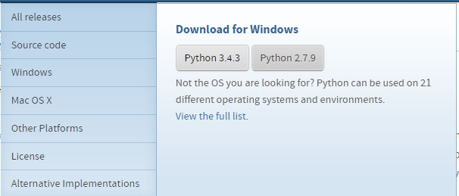
3. IDLE Development Environment
Shell for interactive evaluation.
Text editor with color-coding and smart indenting for
creating python files.
Menu commands for changing system settings & running files.
https://www.python.org/

Slide 8
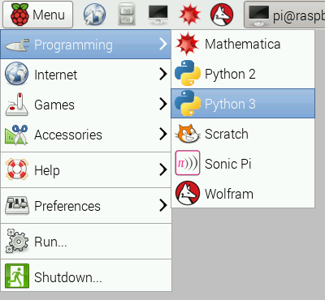
IDLE
A Python integrated development environment.

Slide 9
Lines and Indentation
In a Python program, indentation instead of braces is used to indicate a block of code for a class and a function definition, loop and flow control.
All statements within the block must be indented by the same number of spaces. Example:
if True:
print("True")
else:
print(‘False’)

Slide 10
Lines:
Quotations in Python: Python accepts single ('), double (") and triple (''' or """) quotes to denote string literals, as long as the same type of quote starts and ends the string.
The triple quotes can be used to span the string across multiple lines.
For example, all the following are legal:
word = 'word'
sentence = "This is a sentence. "
paragraph = '''This is a paragraph. It is made up of multiple lines and sentences.'''

Slide 11
Whitespace
Whitespace matters in Python: especially indentation and placement of newlines
Use a newline to end a line of code
Use \ when must go to next line prematurely
No braces { } to mark blocks of code, use consistent indentation instead
First line with less indentation is outside of the block
First line with more indentation starts a block
A Colon starts a new block in many constructs, e.g. function definitions, if-elif-else, for and while loops.

Slide 12
Comments:
A hash sign # that is not inside a string literal begins a comment.
All characters after the # and up to the line end are part of the comment, and the Python interpreter ignores them.
# First comment
print ("Hello, Python!“) # second comment

Slide 13
Basic Datatypes
Integer
z = 5 / 2 # answer is 2.5
Float
x = 3.456
String
Can use " " or ' ' to specify e.g. "abc" == 'abc'
Unmatched ' can occur within the string: "matt's"
Use triple double-quotes for a multi-line string or a string than contains both ' and ", e.g. """a'b"c"""

Slide 14
Variables and Data Types
Python variables do not have to be explicitly declared to reserve memory space.
The declaration happens automatically when you assign a value to a variable. The equal sign (=) is used to assign a value to a variable.
For example:
counter = 100 # An integer assignment
miles = 1000.0 # A floating point
name = "John" # A string

Slide 15
First Program:
// C Program
# include <stdio.h>
void main(void)
{
printf(“Hello world!”);
}
//Java program
public class abc() {
public static void main(String args[])
{
System.out.println("Hello world!");
}
}
# Python program
print (“Hello world!“)

Slide 16
Example 1: command prompt
>>> a=10
>>> b=20
>>> c = a+ b
>>> print(c)
30
>>>
>>>print ("My name is %s and weight is %d kg!" % (‘William', 21))
This will produce the following result:
My name is William and weight is 21 kg!
>>>>

Slide 17
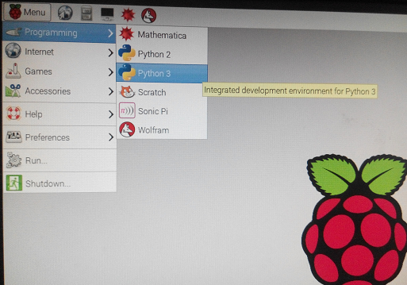
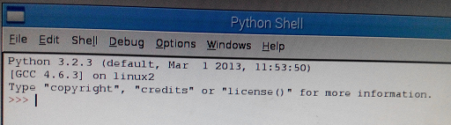
Example 2: Using IDLE 3
Launch Python 3
Go to File > New Window
Type out the code for this example
(next slide)
File > Save As
And then type the file name
and .py (example abc.py) and
click Save
By default, a python source file is
stored in the /home/pi directory

Slide 18
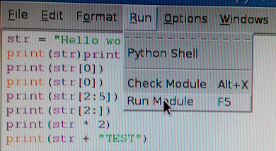
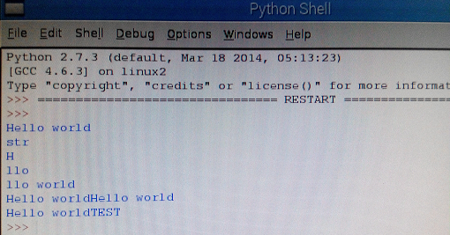
Example 2: Using IDLE 3 continued
Click Run > Run Module
The output is displayed in the new shell like

Slide 19
Example 3: Output
str = 'Hello World! '
print (str) # Prints complete string
print('str')
print (str[0]) # Prints first character of the string
print (str[2:5]) # Prints characters starting from 3rd to 6th
print (str[2:]) # Prints string starting from 3rd character
print (str * 2) # Prints string two times
print (str + "TEST ") # Prints concatenated string
The above code will produce following output:
Hello World!
Str
H
llo
llo World!
Hello World!Hello World!
Hello World!TEST

Slide 20
Example 4: Input
age = input("How old are you? ")
print ("Your age is", age)
print ("You have", (62 - int(age)), "years until retirement“)
The above code will produce following output:
How old are you? 20
Your age is 20
You have 42 years until retirement
>>>

Slide 21
Example 5: Variables
#Variables demonstrated
print ("This program is a demo of variables.")
v = 1
print("The value of v is now", v)
v = v + 1
print("v now equals itself plus one, making it worth", v)

Slide 22
Example 6: Calculate the square root
# Python Program to calculate the square root
# change this value for a different result
num = 8
# uncomment line below to get input from the user
#num = float(input('Enter a number: '))
num_sqrt = num ** 0.5
print('The square root of %0.3f is %0.3f'%(num ,num_sqrt))
The square root of 8.000 is 2.828

Slide 23
Example 7: strings
#Giving variables text, and joining text.
word1 = "Good"
word2 = "morning"
word3 = "to you too!"
print(word1, word2)
sentence = word1 + " " + word2 + " " + word3
print(sentence)

Slide 24
Example 8: if-else
grade = 60
if grade >= 70:
print ("Congratulations!")
else:
print ("You could do so much better.")
print ("Try harder")
The above code will produce following output:
You could do so much better.
Try harder.

Slide 25
Example 9: elif
z = 4
if z > 70:
print("Something is very wrong")
elif z < 7:
print("This is normal")
else:
print(“Everything is wrong")
The above code will produce following output:

Slide 26
Example 10: Find the largest number
# change the values of num1, num2 and num3
# for a different result
num1 = 10
num2 = 14
num3 = 12
# uncomment following lines to take three numbers from user
#num1 = float(input("Enter first number: "))
#num2 = float(input("Enter second number: "))
#num3 = float(input("Enter third number: "))
if (num1 > num2) and (num1 > num3):
largest = num1
elif (num2 > num1) and (num2 > num3):
largest = num2
else:
largest = num3
print("The largest number between",num1,",",num2,"and",num3,"is",largest)
The largest number between 10 , 14 and 12 is 14

Slide 27
Example 11: for
for n in range(1, 4): print ("This is the number", n)
fruits = ['banana', 'apple', 'mango']
for fruit in fruits: # Second Example
print ('Current fruit : ', fruit)
The above code will produce following output:
This is the number 1
This is the number 2
This is the number 3
Current fruit : banana
Current fruit : apple
Current fruit : mango
>>>

Slide 28
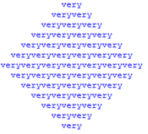
Example 12: for
Enter the following at the command prompt:
>>> a = [1, 2, 3, 4, 5, 6, 7, 6, 5, 4, 3, 2, 1]
>>> b = [' ' * 2 * (7 - i) + 'very' * i for i in a]
>>> for line in b: print (line)
The expected output is:

Slide 29
Example 13: for Loop with list
Enter the following at the command prompt:
num_list = [2, 5, 9, 1, 4]
total = 0
for num in num_list:
total += num
print ("Total: ", total)
The expected output is:
'Total: 21'

Slide 30
Example 14: while
count = 0
while (count < 9):
print ('The count is:', count)
count = count + 1
print ("Good bye!")
The code above produces the following output:
The count is: 0
The count is: 1
The count is: 2
The count is: 3
The count is: 4
The count is: 5
The count is: 6
The count is: 7
The count is: 8
Good bye!
>>>

Slide 31
Example 15: while
Type this in and see what it does.
x = 10
while x != 0:
print(x)
x = x - 1
print("Wow, we've counted x down, and now it equals", x)
print ("And now the loop has ended. ")

Slide 32
Example 16:Guessing Game
import random
n = random.randint(1, 99)
guess = int(input("Enter an integer from 1 to 99: "))
while n != "guess":
print
if guess < n:
print "guess is low"
guess = int(input("Enter an integer from 1 to 99: "))
elif guess > n:
print "guess is high"
guess = int(input("Enter an integer from 1 to 99: "))
else:
print "you guessed it!"
break
print

Slide 33
Example 17: guessing number game
# This is a guessing number game.
import random
guessesTaken = 0
print('Hello! What is your name?')
myName = input()
number = random.randint(1, 20)
print('Well, ' + myName + ', I am thinking of a number between 1 and 20.')
while guessesTaken < 6:
print('Take a guess.')
guess = input()
guess = int(guess)
……..continued to the next page

Slide 34
Example 17: continued
guessesTaken = guessesTaken + 1
if guess < number:
print('Your guess is too low.')
elif guess > number:
print('Your guess is too high.')
else: #if guess == number:
break
if guess == number:
guessesTaken = str(guessesTaken)
print('Good job, ' + myName + '! You guessed my number in ' + guessesTaken + ' guesses!’)
else: #if guess != number:
number = str(number)
print('Nope. The number I was thinking of was ' + number)

